Slide 1
Mapping ER to Relational Model
Rupa Mehta
COED, SVNIT

Slide 2
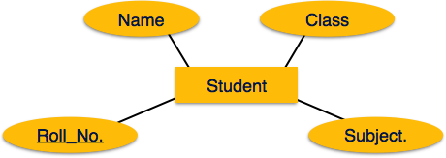
Mapping Entity
Create table for each entity.
Entity's attributes should become fields of tables with their respective data types.
Declare primary key.

Slide 3
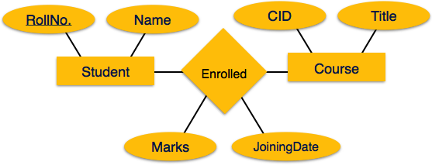
Mapping Relationship
Create table for a relationship.
Add the primary keys of all participating Entities as fields of table with their respective data types.
If relationship has any attribute, add each attribute as field of table.
Declare a primary key composing all the primary keys of participating entities.
Declare all foreign key constraints.

Slide 4
Weak Entity
Strong Entiry

Slide 5
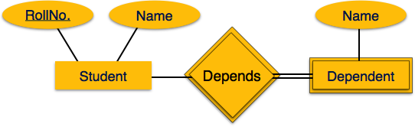
Mapping Weak Entity Sets
P_ID
A weak entity set is one which does not have any primary key associated with it.
Mapping Process
Create table for weak entity set.
Add all its attributes to table as field.
Add the primary key of identifying entity set.
Declare all foreign key constraints.

Slide 6
Mapping Weak Entity Sets
Student(Roll_no, Name)
Dependent (Roll_no, p_id, Name)
_depends(RollNo)
Mapping Process
Create table for weak entity set.
Add all its attributes to table as field.
Add the primary key of identifying entity set.
Declare all foreign key constraints.

Slide 7
Mapping Weak Entity Sets
P_ID
Year
Student(Roll_no, Name)
PK = Roll_No
[{1,x}, {2,y}]
Roll-no →name
Dependent (R_N, p_id, Name)
[{1,p1, p}, {3,p2,q}]
Foreign key
R_N is a foreign key refering to the PK of Student
R_N,P_id→Name
Depends(RollNo, P_Id, year

Slide 8
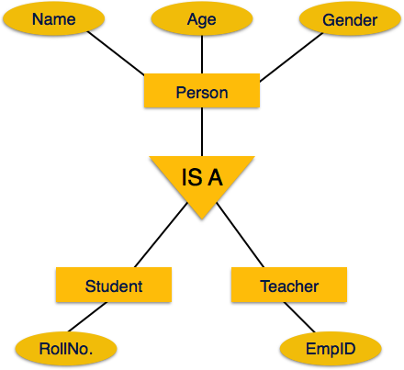
Mapping Hierarchical Entities
ER specialization or generalization comes in the form of hierarchical entity sets.

Slide 9
Mapping Hierarchical Entities
Mapping Process
Create tables for all higher-level entities.
Create tables for lower-level entities.
Add primary keys of higher-level entities in the table of lower-level entities.
In lower-level tables, add all other attributes of lower-level entities.
Declare primary key of higher-level table and the primary key for lower-level table.
Declare foreign key constraints

Slide 10
Mapping Hierarchical Entities
Add primary keys of higher-level entities in the table of lower-level entities.
In lower-level tables, add all other attributes of lower-level entities.
Declare primary key of higher-level table and the primary key for lower-level table.
Declare foreign key constraints
Student(Roll_No, CGPA)
Teacher(EMP_ID, Quali)
Person(P_ID, Name,Age,Gender, cat)
Create table person{ P_ID primary key;
name….
foreign key (P_ID) references
Student(Roll_No) }

Slide 11
Mapping Hierarchical Entities
Student(Roll_No, CGPA)
Teacher(EMP_ID, Quali)
Person(P_ID, Name,Age,Gender, cat)
ISA_1(P_ID, cat)
ISA_2(P_ID,Roll_No)
ISA_3(P_ID,EMP_ID)

Slide 12
Mapping Hierarchical Entities
Student(Roll_No, CGPA)
Teacher(EMP_ID, Quali)
Person(P_ID, Name,Age,Gender, cat)
ISA_2(P_ID,Roll_No)
ISA_3(P_ID,EMP_ID)

